Slide 1

Gesture Recognition Using Artificial Intelligence
Team Id - 48 (ICT)
TEAM MEMBERS:
YUG THAKKAR (18BIT123)
ARYAN PATEL (18BIT005)
DIVY PATEL (18BIT024)
HERAT DEVISHA (18BIT026)
KENIL PATEL (18BIT053)
VISHWA PARMAR (18BIT117)

Slide 2
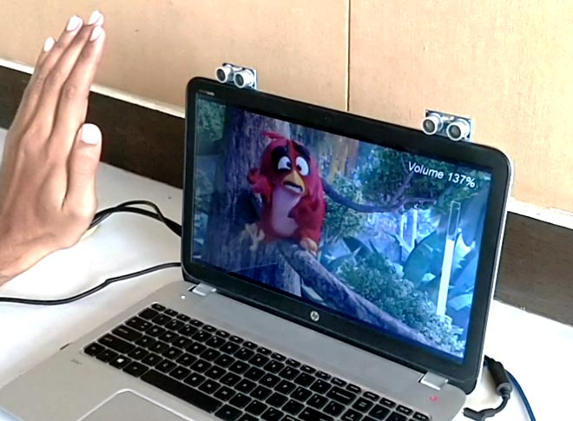
INTRODUCTION
It's recognizes the gestures that the user does while watching his screen of the device.
Based on some specific gestures, the user can control functionality of the Screen.
The user doesn't need to use remote control or other controls to use functionality hence this will be more convenient for the user.

Slide 3

PROBLEM STATEMENT
The gestures are continuously monitored by the webcam used on the Device. Each gesture corresponds to a specific command.
Using the model that we will develop, the live feed from the webcam will be analyzed and the gesture will be recognized.
Based on the gestures recognized, the corresponding functionality will be performed in the Device.

Slide 4
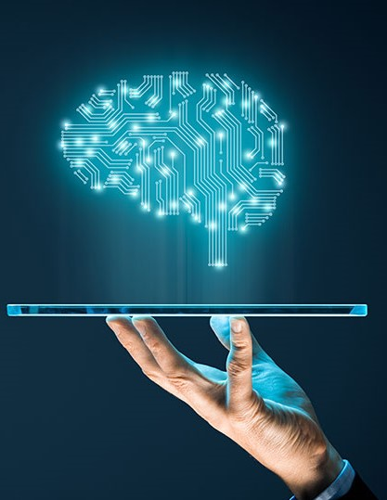
DATASET
DESCRIPTION
We have created our own dataset with total 4 labels.
Dataset is created by combining our own images and taking some relevant images from some existing datasets.
Where, we are having 3 gestures for controlling the display and 1 Ideal Images of a human sitting Ideal in front of computer.
3 different gestures include Thumbs up, Thumbs down and Palm.

Slide 5


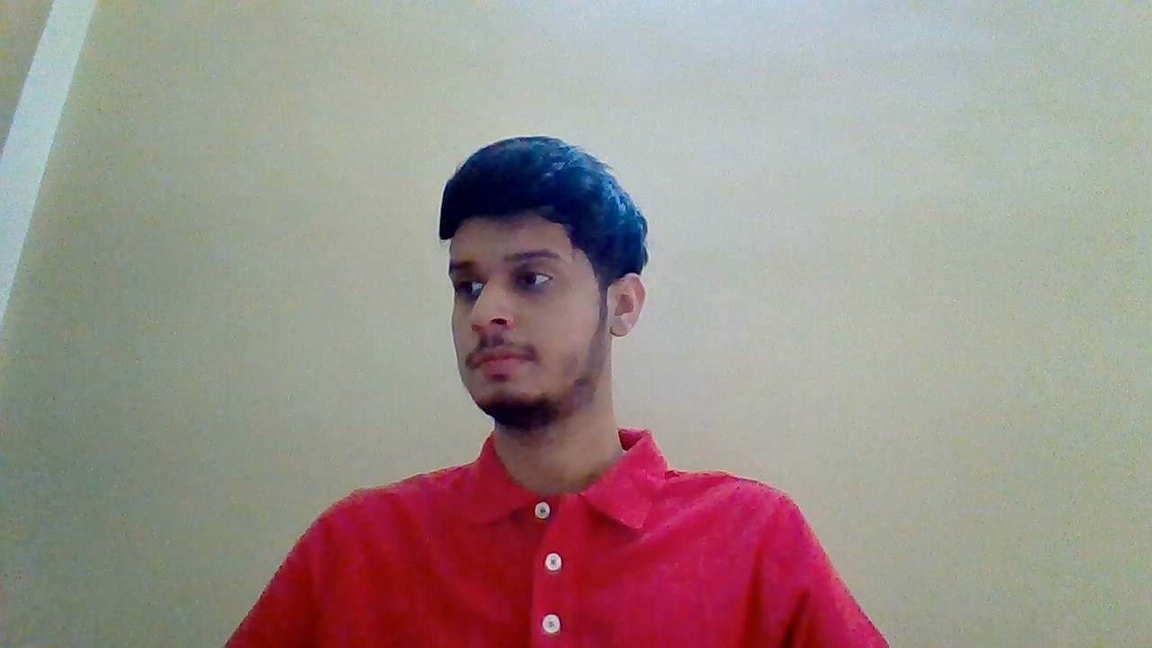
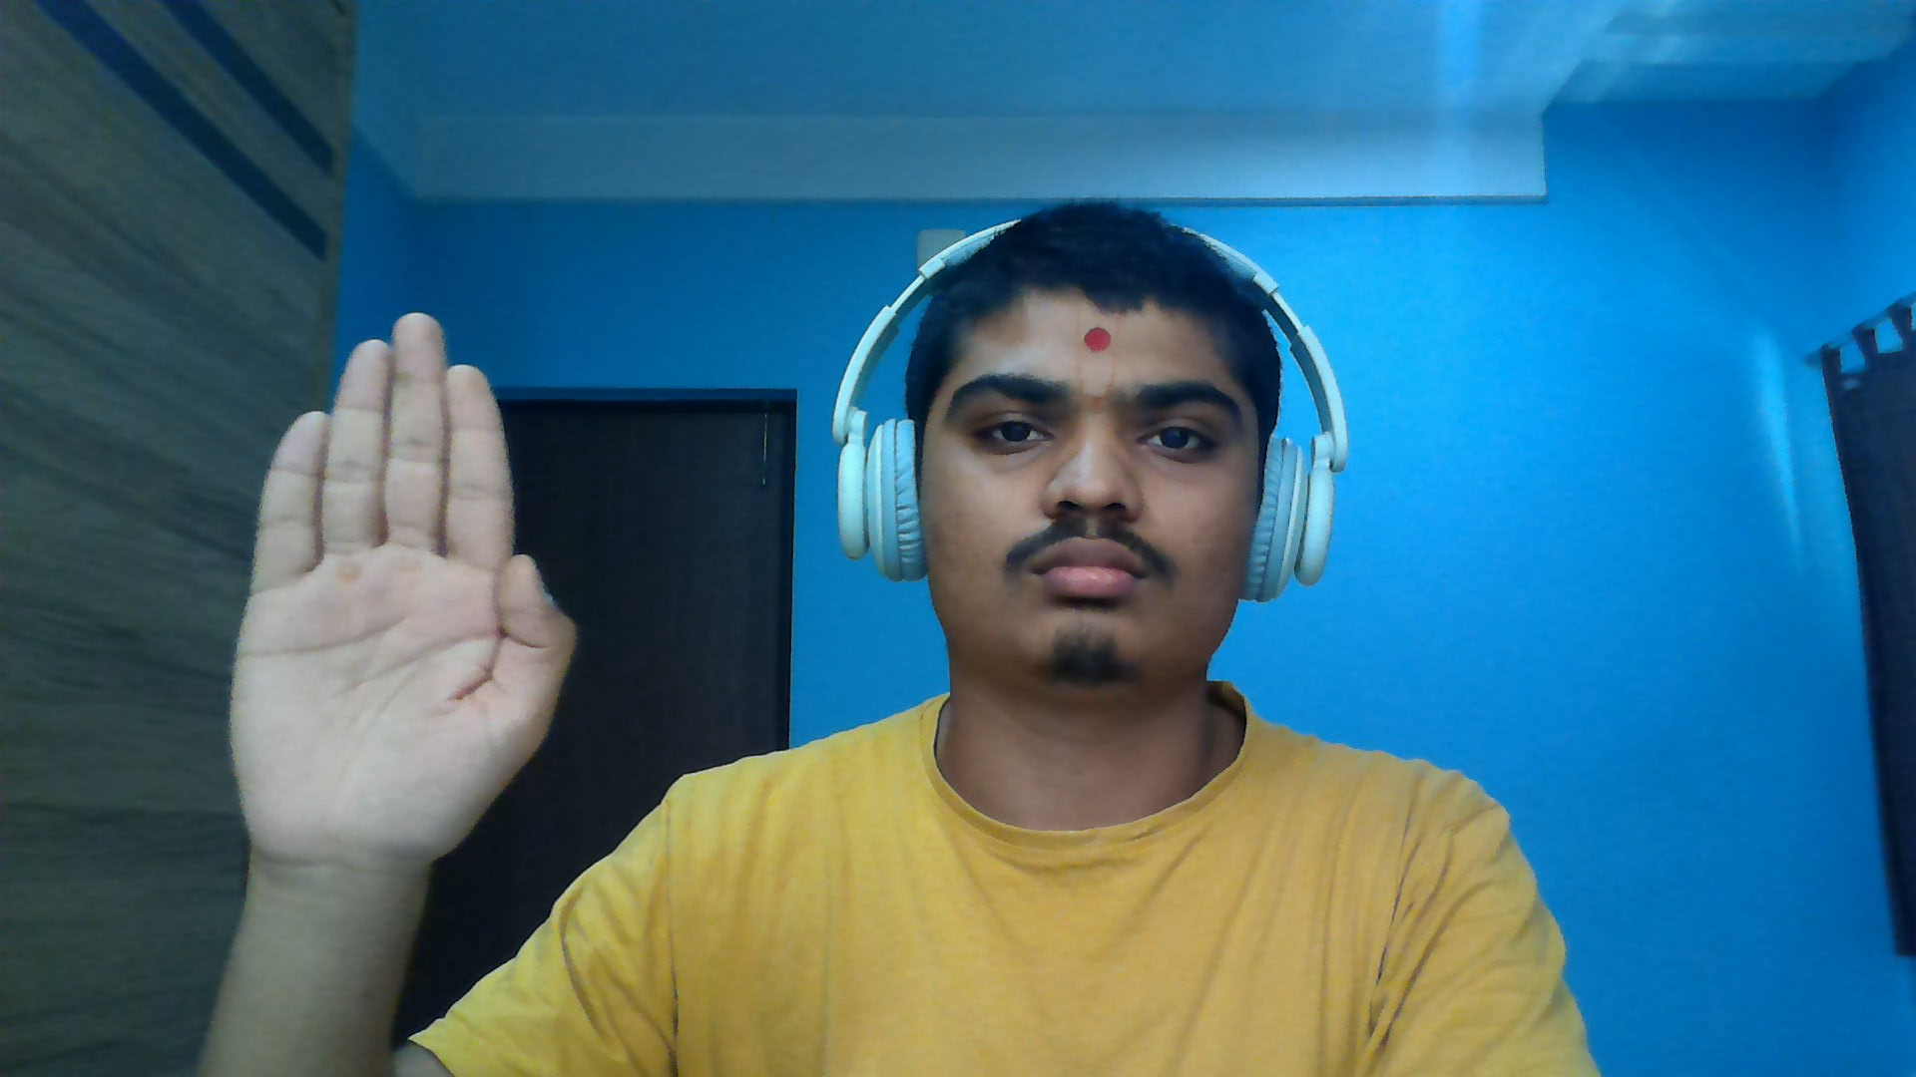
Thumbs down
Thumbs up
GESTURE EXAMLES
Ideal
Palm

Slide 6
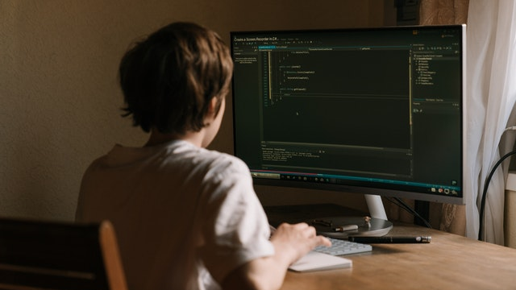
LITERATURE SURVEY
No. | PAPER NAME | DESCRIPTION
1. | Wu Y., Huang T.S. (1999) Vision-Based Gesture Recognition: A Review. In: Braffort A., Gherbi R., Gibet S., Teil D., Richardson J. (eds) Gesture-Based Communication in Human-Computer Interaction. GW 1999. Lecture Notes in Computer Science (Lecture Notes in Artificial Intelligence), vol 1739. Springer, Berlin, Heidelberg. https://doi.org/10.1007/3-540-46616-9_10 | The use of gesture as a natural interface serves as a motivating force for research in modeling, analyzing and recognition of gestures. Human computer intelligent interaction needs vision-based gesture recognition, which involves many interdisciplinary studies. A survey on recent vision-based gesture recognition approaches is given in this paper. We shall review methods of static hand posture and temporal gesture recognition. Several application systems of gesture recognition are also described in this paper. We conclude with some thoughts about future research directions.
2. | Oudah M, Al-Naji A, Chahl J. Hand Gesture Recognition Based on Computer Vision: A Review of Techniques. Journal of Imaging. 2020; 6(8):73. https://doi.org/10.3390/jimaging6080073 | This paper focuses on a review of the literature on hand gesture techniques and introduces their merits and limitations under different circumstances. In addition, it tabulates the performance of these methods, focusing on computer vision techniques that deal with the similarity and difference points, technique of hand segmentation used, classification algorithms and drawbacks, number and types of gestures, dataset used, detection range (distance) and type of camera used. This paper is a thorough general overview of hand gesture methods with a brief discussion of some possible applications.

Slide 7
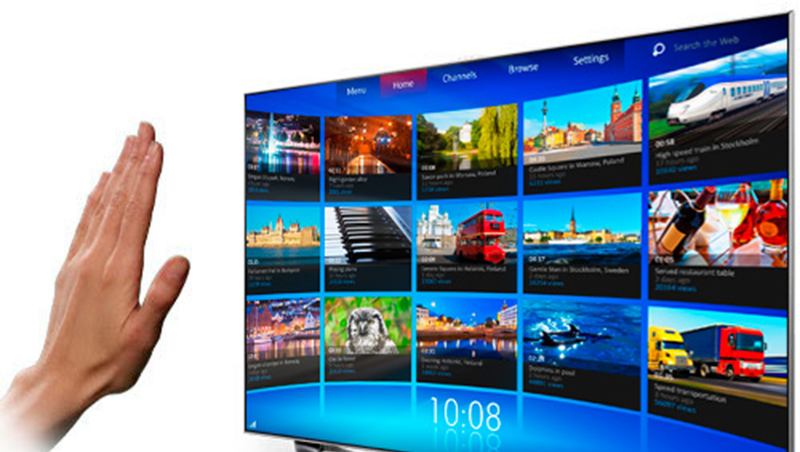
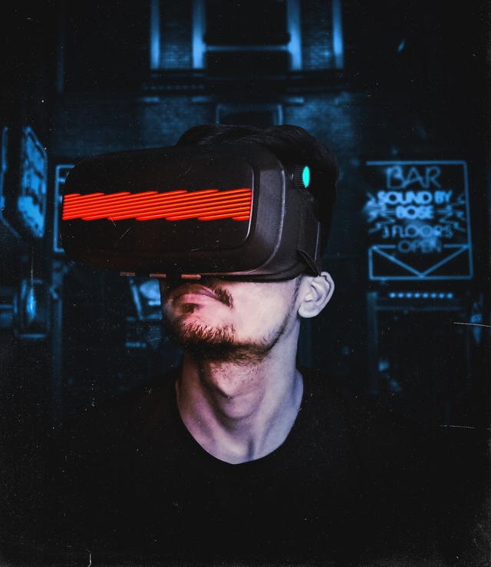
PLANNED
METHODOLOGY
Thumbs up : Increase Volume
Thumbs down : Decrease Volume
Stop : Pause Video
Ideal : Does Nothing

Slide 8
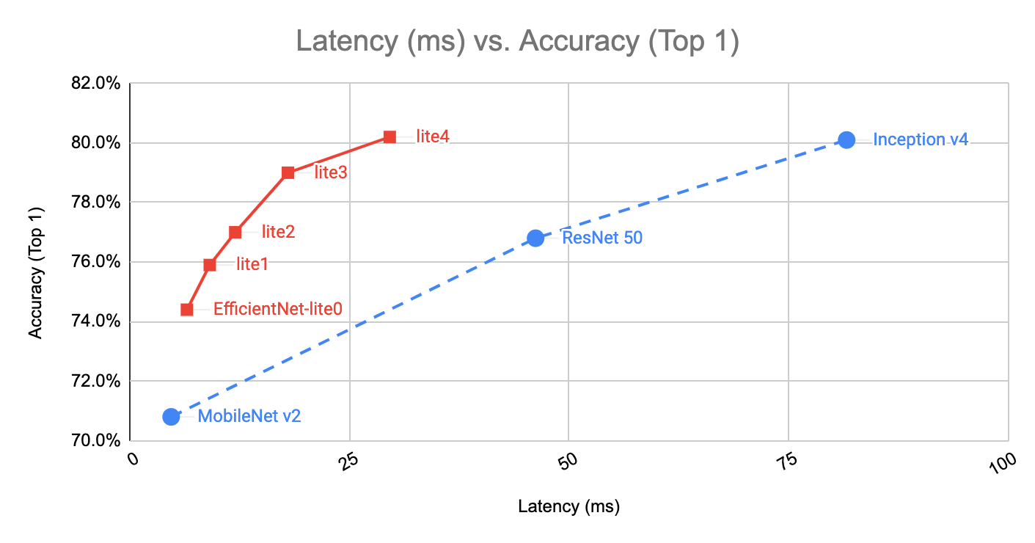
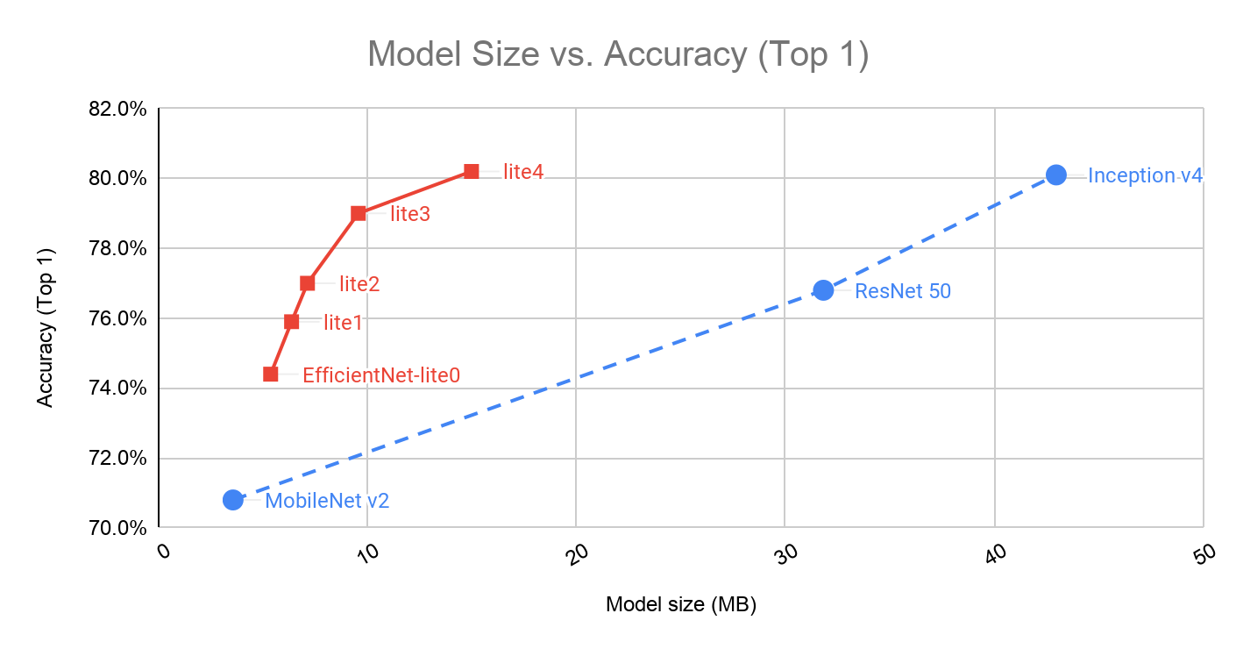
Pre-Trained Models

Slide 9
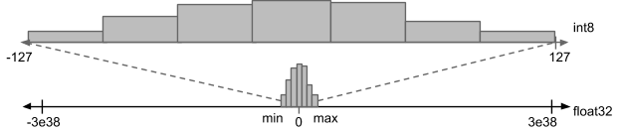
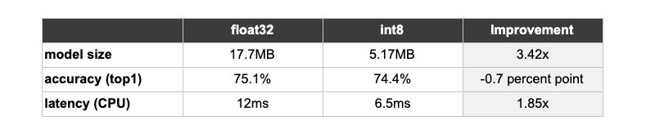
Quantization

Slide 10
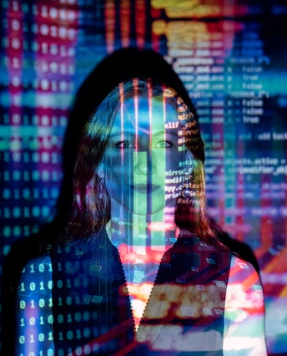

MODEL DESCRIPTION
We are using MobileNetV2 with “imagenet” weights and excluding the top layer to get image features in shape of (12,12,1280) by inputing the image with shape of (360,360,3).​
After this we are splitting the feature data into train, test and validation data.​
Then we are training 2 layered ANN, with Input layer just to pass the input to next layer.
“ReLu” activation function with 100 neurons.​
“SoftMax” activation function with 4 neurons as output layer. As we are having 4 classes of outputs(“Stop”,”Ideal”,”Up”,”Down”)​

Slide 11

ACCURACY
Our accuracy on training data: 96.54%
Our accuracy on validation data: 94.59%​
Our accuracy on testing data: 95.32%​

Slide 12
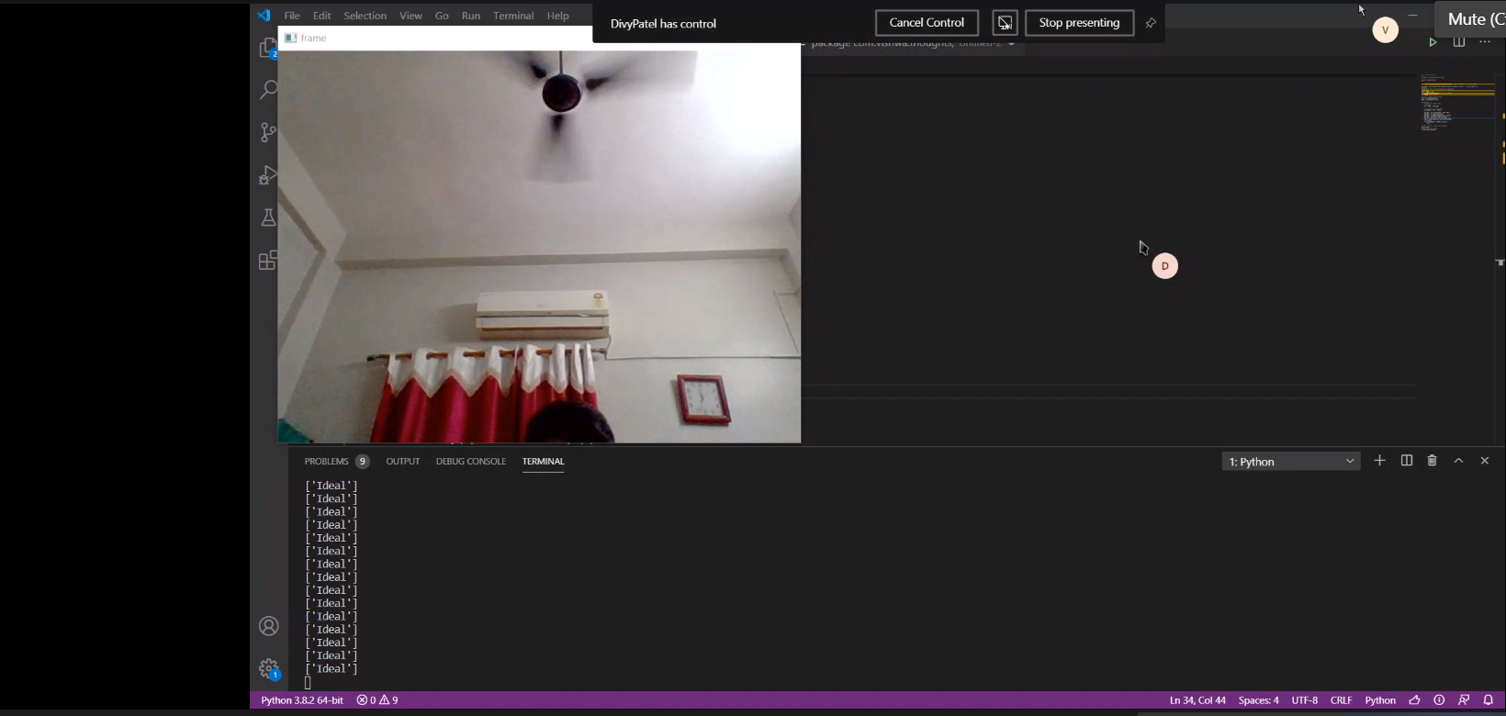
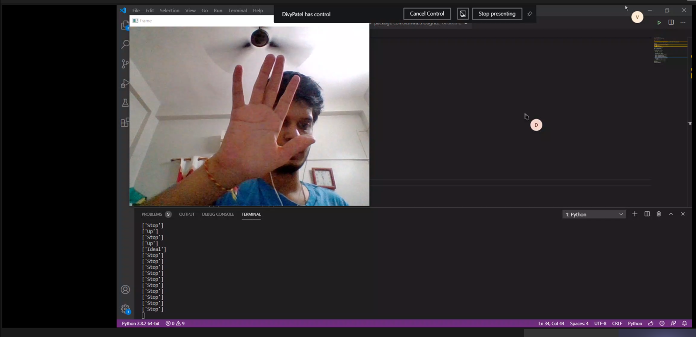
RESULTS
Ideal / No Gesture
Stop Gesture

Slide 13
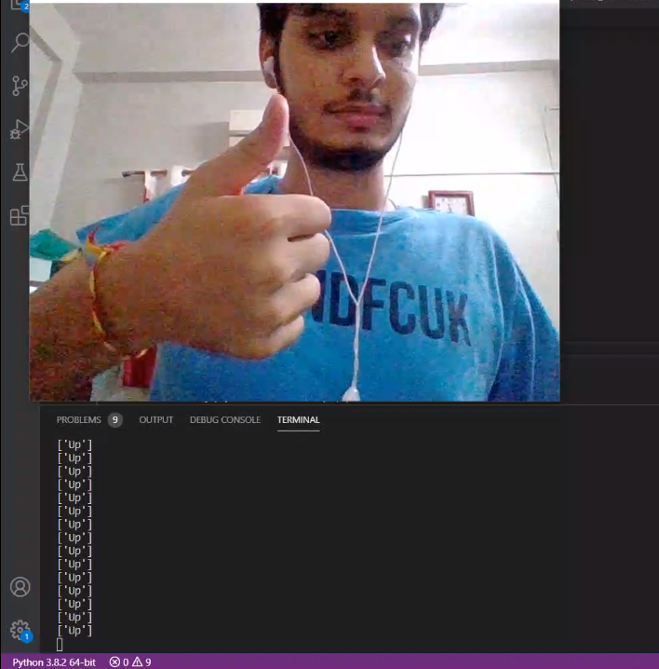
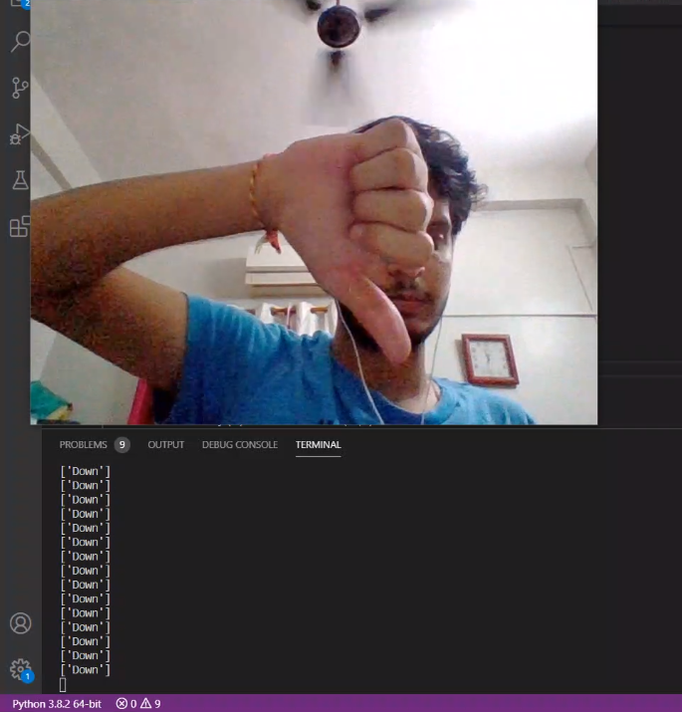
RESULTS
Up Gesture
Down Gesture

Slide 14
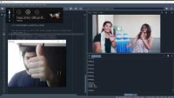
DEMO VIDEO

Slide 15
IMPORTANT LINKS
GitHub Repository Link:- https://github.com/kenil121200/Hand-gesture-recognition-for-human-computer-interaction
To Download Dataset:- Download Link
To Download Full Model Folder:- Download Link
To Download All Numpy Data File:- Download Link
Video Demo:- Play Video

Slide 16
THANKS

